Slide 1

Wine Quality Prediction.
Capstone Project On
August 8, 2021
Name – Saiteja C
Batch – 28th June 2021

Slide 2

Agenda
Analyze Data
Treat Outliers
Build Model
Prediction On Data
Exporting (or) Saving The Result File

Slide 3

Prediction Format
Our predicted variable ​will be considered as below,
If quality of wine is less than 6(<6), it is considered as ‘Bad’ quality
Where as if quality of wine is more than or equal to 6(>=6), it is considered as ‘Good’ quality

Slide 4
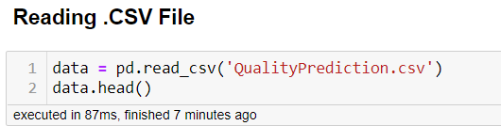
Import Data File
First step in our process is to import the data file into our notebook.
We can pass path of our file as a parameter in read_csv(), if it is not in our present working directory.

Slide 5
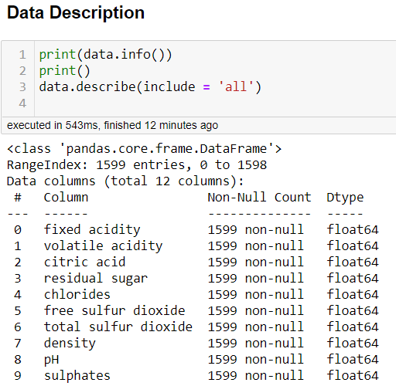
Summarizing Data
Data can be inspected whether it has any null values or the data types of the columns etc using describe function. Which gives a whole data set summary.

Slide 6
Outliers visualization and treating them
Outliers in the data are those which may cause our predictions biased and deviate our mean of data.
Outliers may cause because of human errors or computational mistakes etc. Which has to be treated to get the correct predictions.
We Visualized each column outliers and used ‘Z-score’ method to remove the outliers and make our data normally distributed.

Slide 7
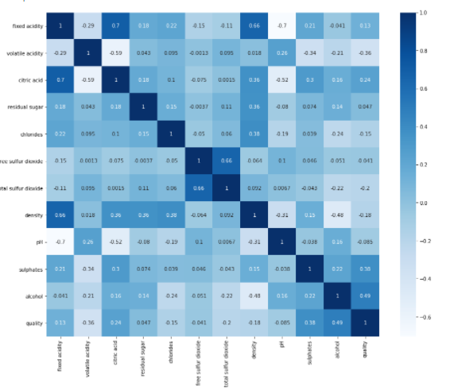
Correlation Analysis
Correlation gives us the relation between two variables, in which change of one variable how is it effecting the other variable.
Correlation is measured form -1 to 1, 1 shows highly correlated in positive direction(directly proportional), where as -1 shows highly correlated in negative direction(Inversely proportional).
We used correlation matrix with heat map to visualize the correlation among the features and analysed them.

Slide 8
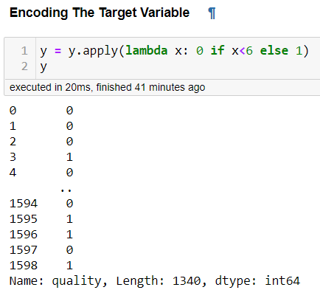
Dividing target and independent variable and encoding the target variable.
We need to separate the dataset into target variable and independent variables which contribute for target variable.
As we are predicting good and bad for our wine quality, we need to encode our target variable to binary format to make our machine understand the data.
We used apply function to make our target variable to a binary format.

Slide 9
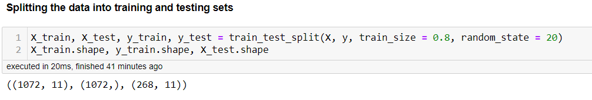
Train Test Split
We split our data into train and test set using inbuilt function of model_selection package.
We don’t expose our test data to our model and it should only learn on test data and predict the target on test data.
To check our model accuracy we need to split our original data into test and train data.

Slide 10
Initialize Random forest And Set Optimum Parameters
We initialize random forest model which is from ensemble package.
We used OOB Score to find the best iteration number to get our error as low as possible. OOB score gives us n_estimators optimum value for our model. n_estimators describe number of decision trees in out model.
We used ‘Grid Search Cross Validation’ by passing all the possible parameters to grid search CV which gives us the optimum parameters to use. This is called ‘HyperParamterTuning’
After finding the optimum parameters for model we set the parameters for our initialized random forest variable.

Slide 11
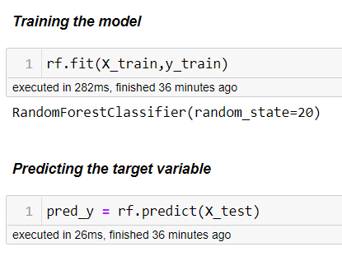
Model fit and predictions
As we initialized our model we next fit our model on our training data this means, our model learns and understand the data in its own way.
Next after model learnt on training data we predict our target value using test data here we don’t fit or make our model learn again as it already learnt on test data.
As expected, our model returns predicted target values.

Slide 12
Evaluating the model
We check our accuracy, which means our total correct predictions over total number of predictions, which decides how good our model learnt and performed.
Next is by using Confusion Matrix, which gives us the TP, TN, FP and FN of our model, which gives us the idea how our model predicting and in which areas its predictions are mostly wrong.
We also used ROC curve which gives us AUC(area under curve), which gives us a curve between TPR and FPR and our expectation should be getting more TPR
By calculating we get a value of AUC which represents the area under the curve of ROC.
Classification Report gives us the Precision, Recall, F1 score, and respective accuracy, macro average and weighted average, by which we can evaluate our model on predictions.

Slide 13
Saving the prediction file
As we built our model, now we predict on whole initial dataset and get the predictions.
Transforming the Predicted column into ‘Bad’ and ‘Good’, 0’s are Bad and 1’s are Good.
After encoding the predicted values we merged the column with our original dataset using numpy where condition.
Saving the file using to_csv(), saves our file with all our predictions in the dataset.

Slide 14

Thank You
August 8, 2021
Name – Saiteja C
Batch – 28th June 2021

